Slide 1
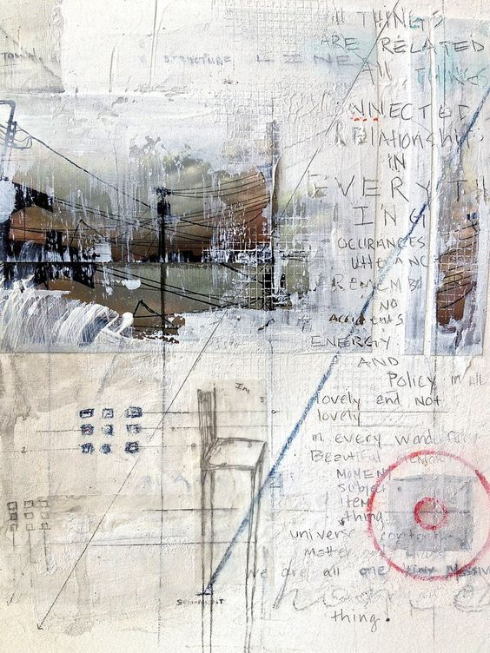
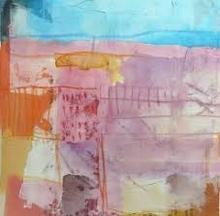
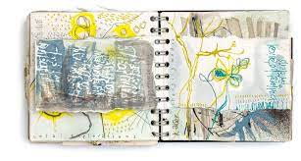
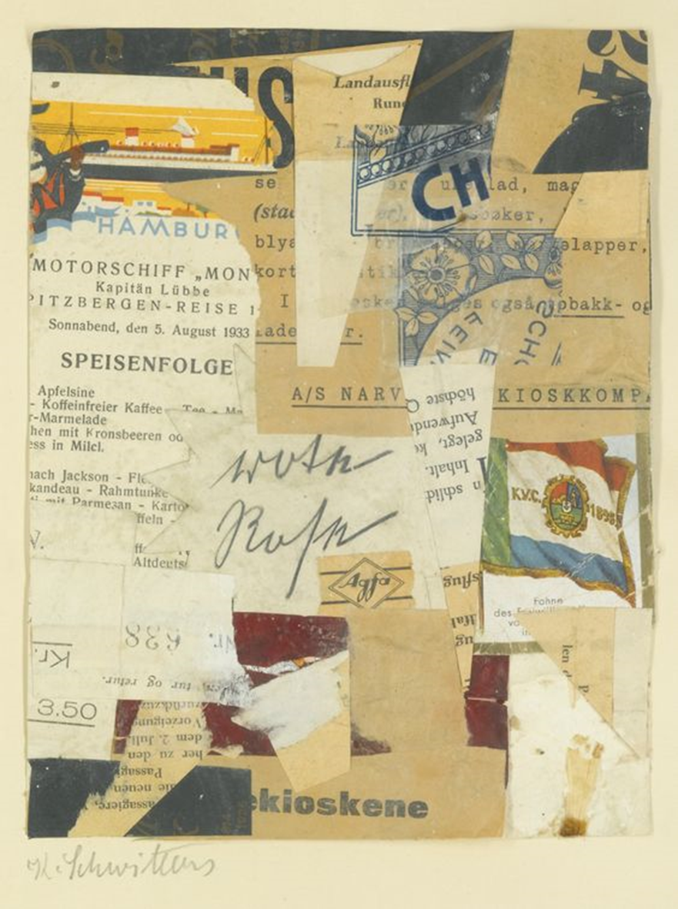
11 into 12 Art Summer Homework
Make your own sketchbook
2. Fill your sketchbook book with a ‘SUMMER’ aesthetic, each page may be linked to a place, something you did, how you felt, who you saw to name but a few. Remember all the elements we discussed in your taster day to help make each page the best it can be.

Slide 2
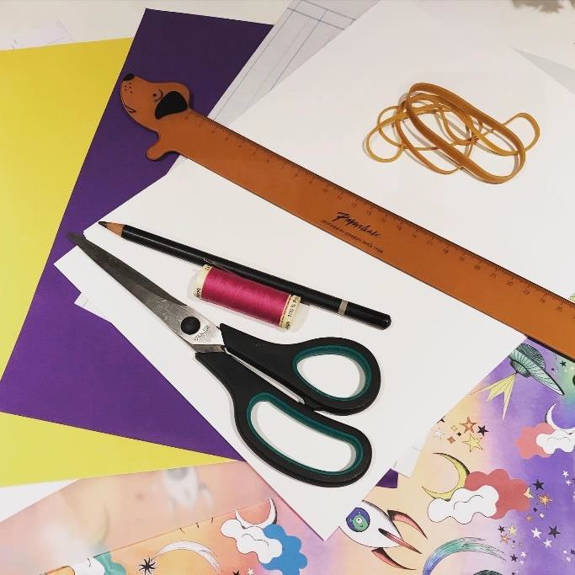
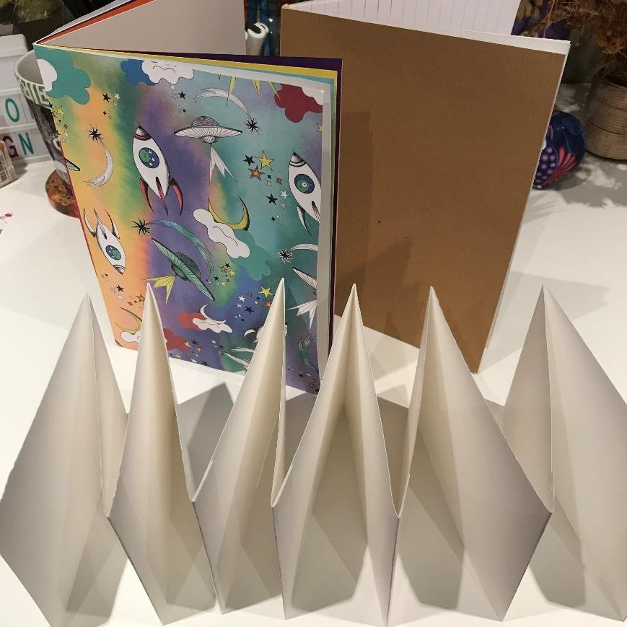
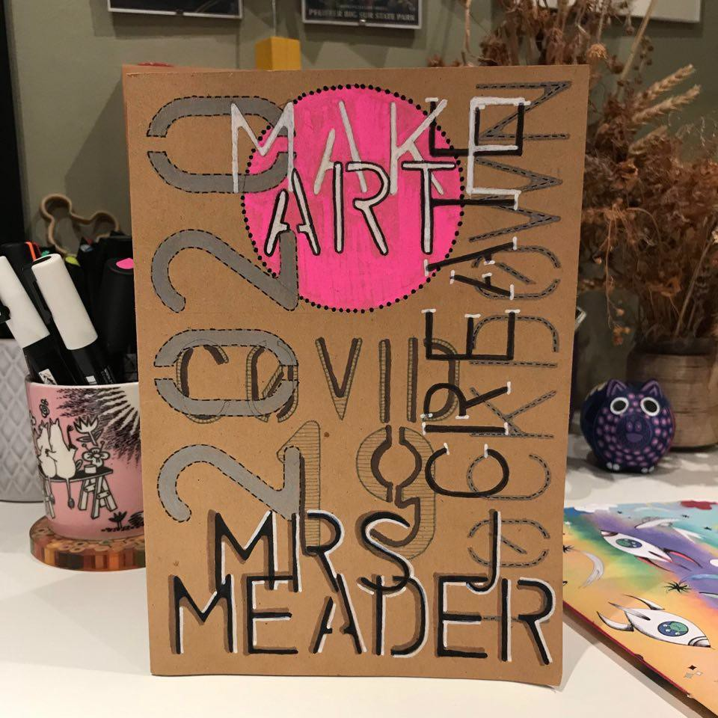
How to make a sketchbook.
Making yourself a sketchbook is pretty easy and the best thing is that you can choose what paper you would like to use and what size you would like it to be. You could use plain white paper or a mixture of plain, coloured and lined. You could also recycle old books, magazines or wrapping paper to make a cover. Here are the instructions of three different ways to make a sketchbook.

Slide 3
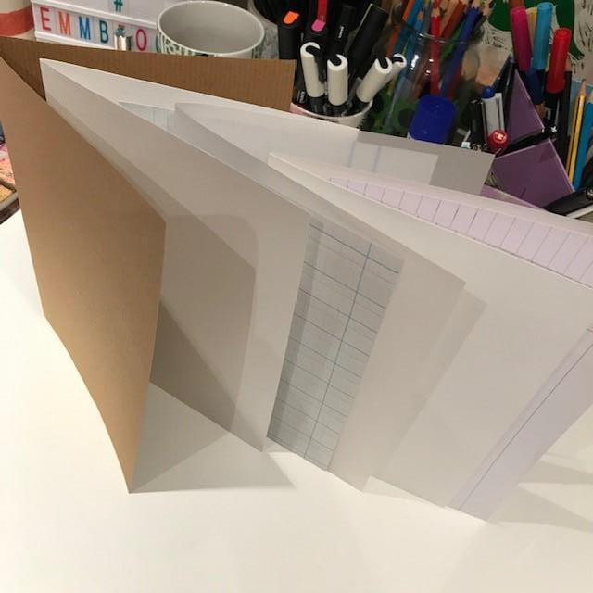
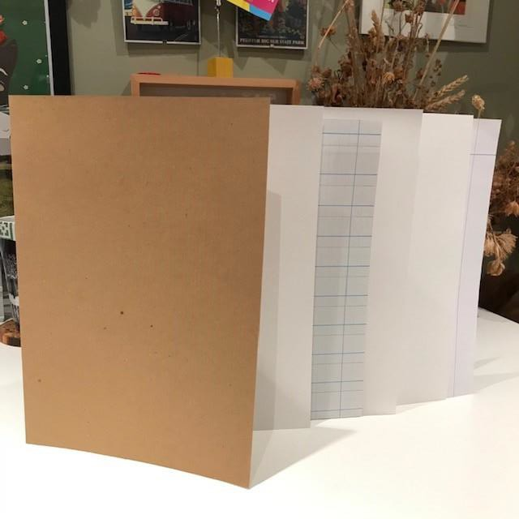
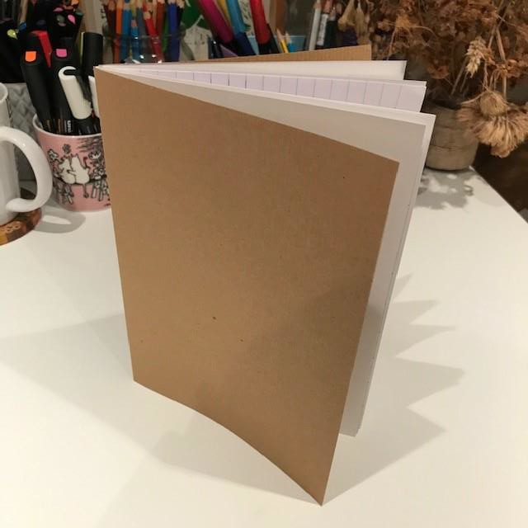
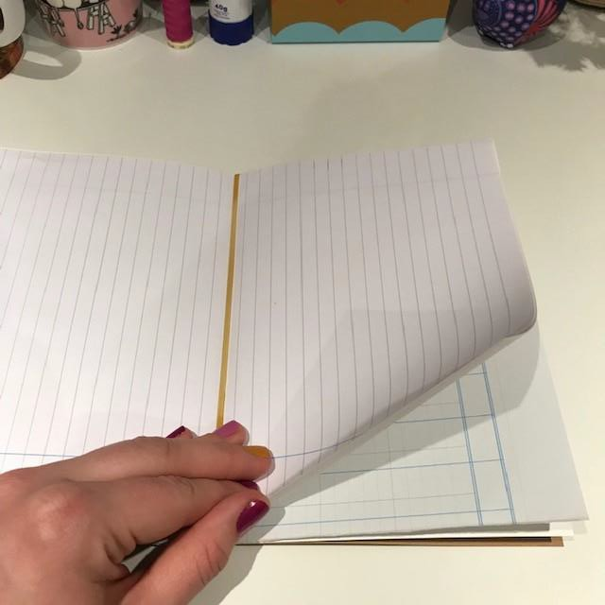
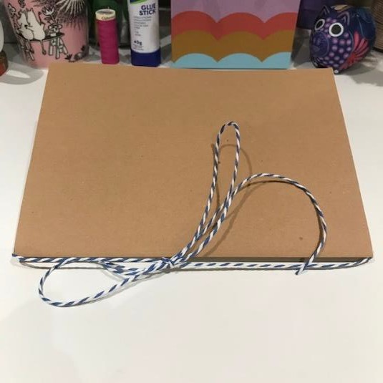
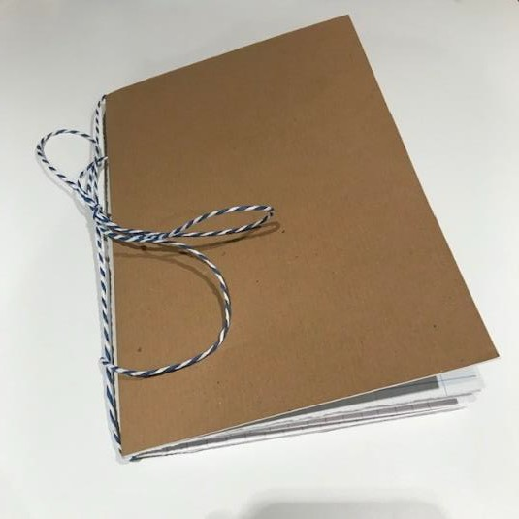
Simple Folded Sketchbook
To make this simple sketchbook you need 6 pieces of A4 paper and a large elastic band or string.
First, fold your pieces of paper in half. Once you have folded them in half, tuck them inside of each other to make a booklet.
OR
Finally open the booklet to the middle page and lay flat on the table. To hold all your pages together carefully wrap the elastic band over all the pages into the centre fold OR use some string or ribbon to wrap around centre fold and tie in a knot.

Slide 4
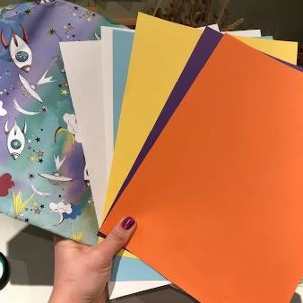
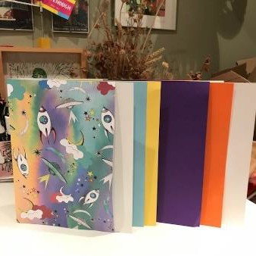
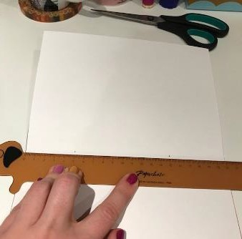
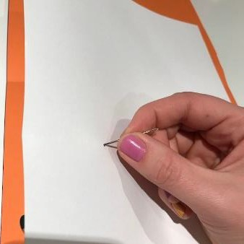
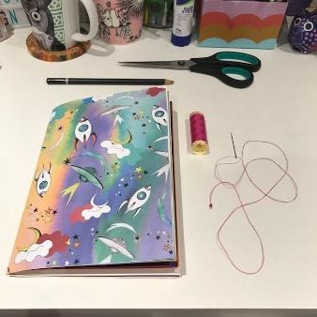
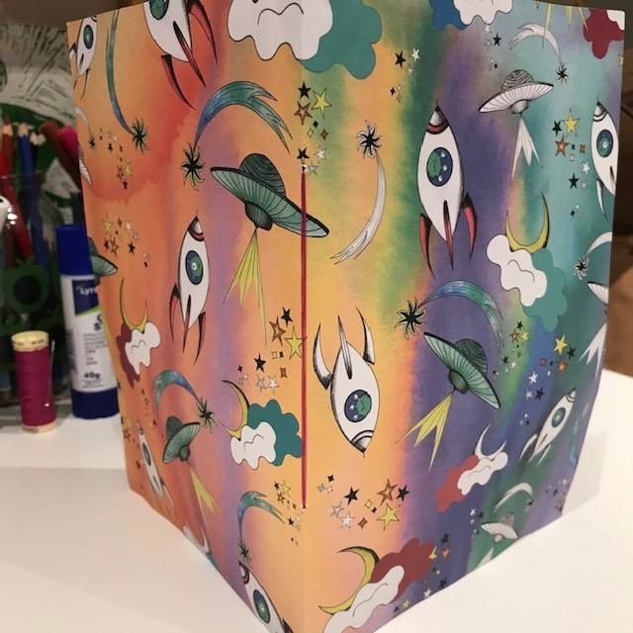
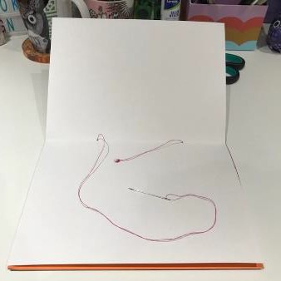
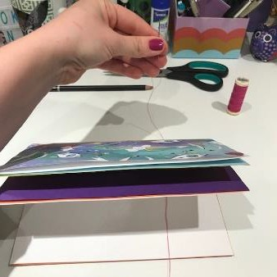
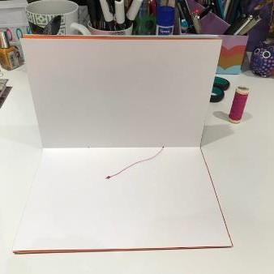
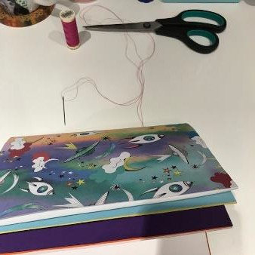
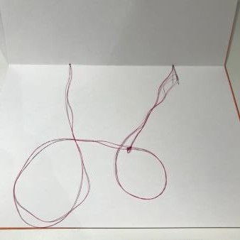
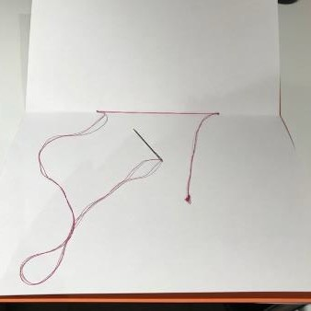
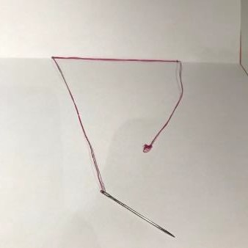
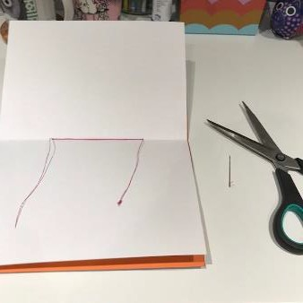
Simple Stitched Sketchbook
To make this simple stitched sketchbook you need 6 pieces of A4 paper, an extra piece of paper for the cover, a ruler, a pencil and some cotton thread and a needle.
First, fold your pieces of paper in half. Once you have folded them in half, open each of the pages out and mark a small dot in the centre fold at 5cm and 15cm. Then use the needle to push a hole through each the dots you have made.
Next tuck all your pages inside of each other to make a booklet. Cut a long piece of
thread and put it through the needle. Double it up and tie a knot in the end.
You need to finish with the needle in the centre of the booklet. Lastly, cut the needle off the thread and tie it with the 10cm knotted end that you left.
From the inside of the booklet put the needle though one of the holes and through all the pages until you come out of the cover. Leave around 10cm of thread with the knot on the end in the centre of the booklet. Then put the needle through the next hole on the outside cover and thread through the pages until it comes out through the centre page again. Repeat this two more times.

Slide 5
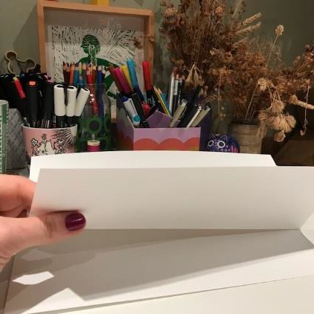
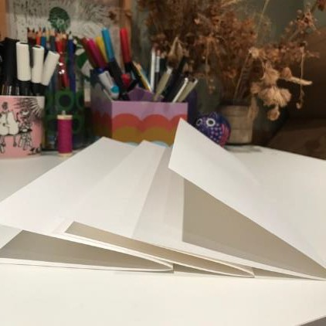
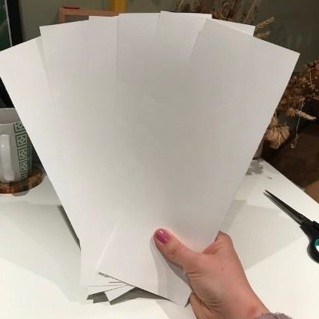
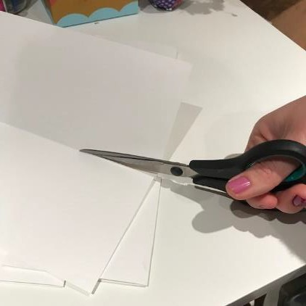
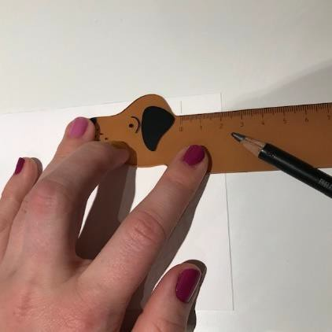
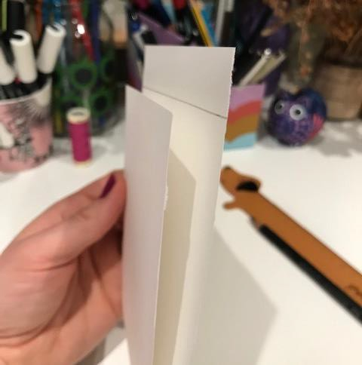
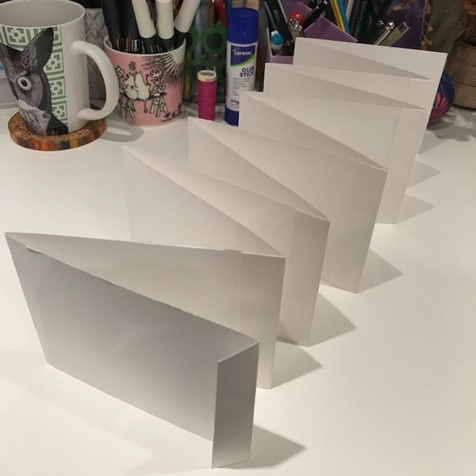
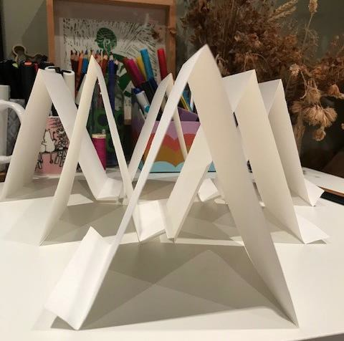
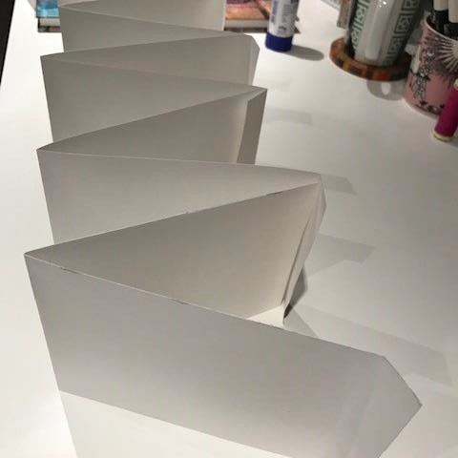
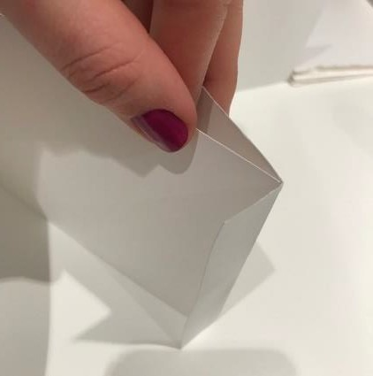
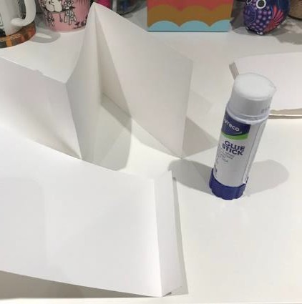
Mini Concertina Sketchbook
To make this simple stitched sketchbook you need 6 pieces of A4 paper, a pair of scissors, a ruler, a pencil and glue stick.
First, fold your pieces of paper in half along the longest side then cut along the fold lines so that you end up with 6 long pieces of paper.
Measure a 2cm strip along the width of each of the pieces of paper. Fold the paper in half to this line and then fold the paper over on the line so that you end up with a tab on each of the folded pieces.
Lastly, line up each of the pages so that the tabs line up with the next then glue them together.

Slide 6
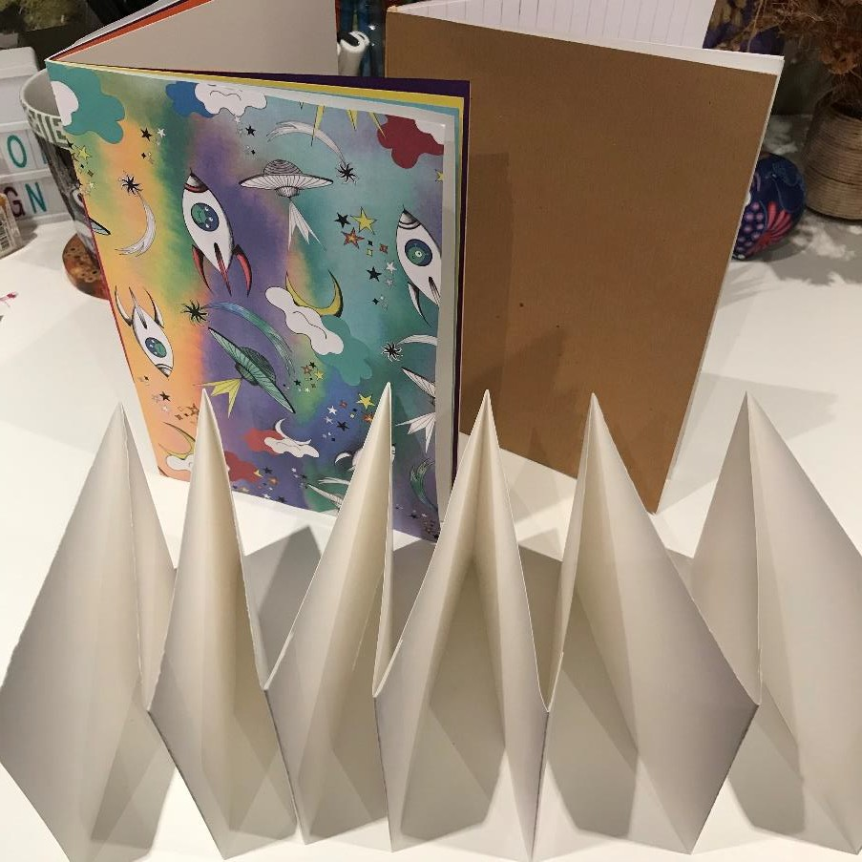
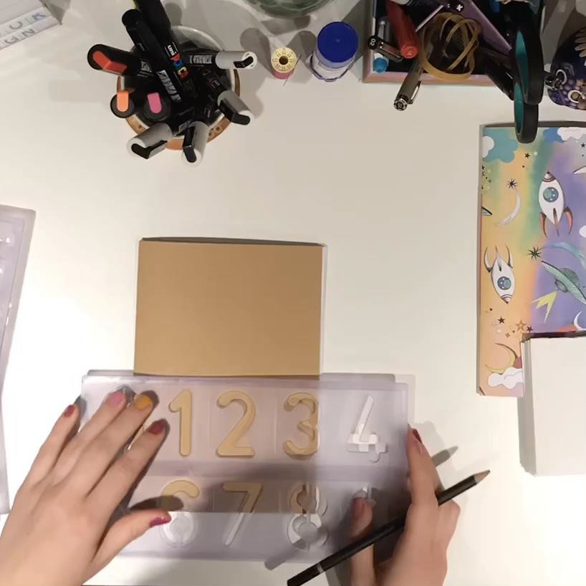
Create a cover or title page for your sketchbook.
Once you have made your sketchbook, you need to decorate the cover – this can be using whatever materials you like. If you have used some wrapping paper to cover your book then you should decorate the first page instead.
I decided to use a stencil and put text on my cover, using different pens and pencils. I also have limited colours.
You could use paint, pencil, pen, stencils, printing, stamps, collage, stickers, doodles, photos…anything you like! Make it personal to you, your interests and a style of art you like.

Slide 7
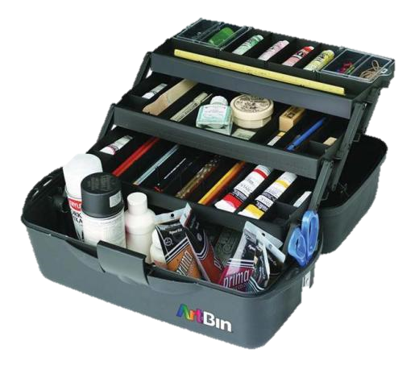
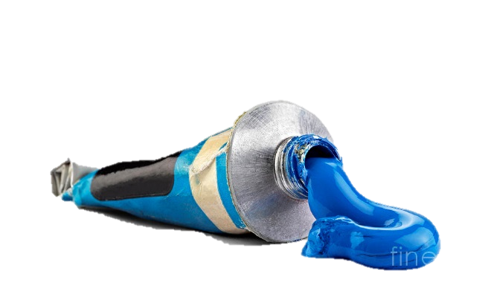
ART A Level EQUIPMENT KIT 2022-23
Pritt stick (you will be expected to bring your own to lesson throughout the whole year)
Decent set of watercolour paints
Set of brushes
Set of sketching pencils (2B 4B etc)
Set of acrylic paints
Sharpener
Rubber
A contribution of £20 towards the many items of specialist equipment we provide for you during the course.
REMEMBER TO ENSURE YOUR MATERIALS ARE ALL LABELLED WITH YOUR NAME AND ARE STORED IN AN APPROPRIATE CONTAINER WHICH CAN BE TAKEN TO OR FROM HOME.
YOU ARE EXPECTED TO BRING THIS KIT IN FULLY LABELLED ON YOUR FIRST LESSON IN SEPTEMBER

