Slide 1
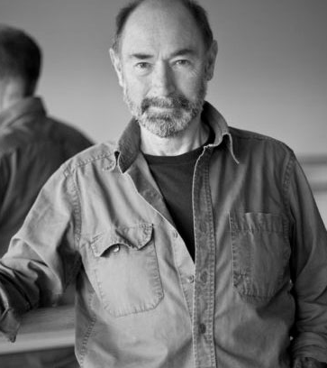
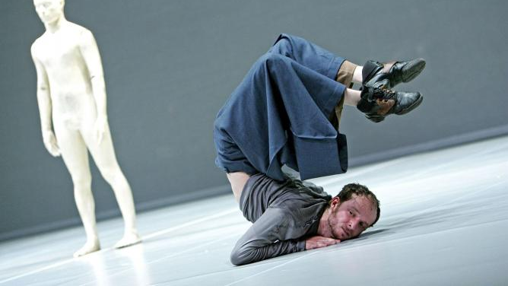

Year 11 – 12
Summer bridging work
A Level Dance

Slide 2
Research should include:
- Training
- Popular works
- Images
- Movement style
- Collaborators
- Venues they have performed in
Research into one of the following practitioners:
Siobhan Davies
Matthew Bourne
Richard Alston
Akram Khan
Christopher Bruce
Sidi Larbi Cherkaoui

Slide 3
Create
Create a short solo in the style of the practitioner you have chosen to research into.
The solo does not need to be longer than 32 counts but does need to show the style you have been researching into!
Make sure you film it so you do not forget it!

