Slide 1
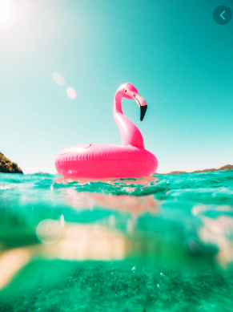
Photography
SUMMER ASSIGNMENT
SHOOT TWO PHOTOGRAPHS
1. LANDSCAPE
RULES: NO sunrises or sunsets
2. PORTRAIT
RULES: The subjects clothes/hair MUST match the background
Choose your best one of each and present to me on the first lesson back to school.
If you’d prefer you can print each one and show them instead.

