Slide 1
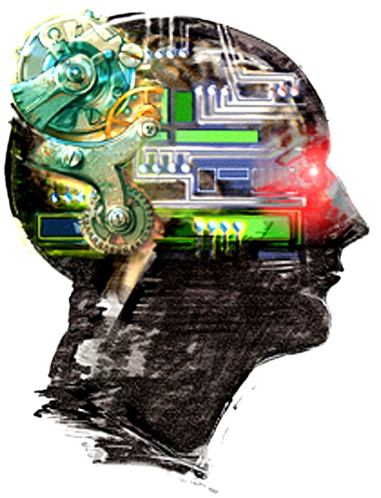
Ethical, moral and cultural issues
Computers in the workforce
A class debate on
“The ethical, moral and cultural implications of automating the workplace.”

Slide 2
Ethical, moral and cultural issues – Task 1
Computers in the workforce
The ethical, moral and cultural implications of automating the workplace
There are already many jobs that didn't exist a few years ago. In the future, there will be many types of jobs that we can't predict today. How have working patterns and practices changed as a direct result of computer technology in the workforce over the last 30 years?
Create a spider diagram to outline the main issues.

Slide 3
Ethical, moral and cultural issues – Task 2
Computers in the workforce
The ethical, moral and cultural implications of automating the workplace
Exam questions on this topic are likely to be open-ended and worth approximately 12 marks. Structure an individual written answer to the debate in 10 minutes.
Demonstrate your knowledge and understanding of the ethical and legal issues.
Apply specific examples and situations.
Draw conclusions, stating how implications may be overcome.
Have this ready to hand in your first lesson back in September 2023.

