Slide 1
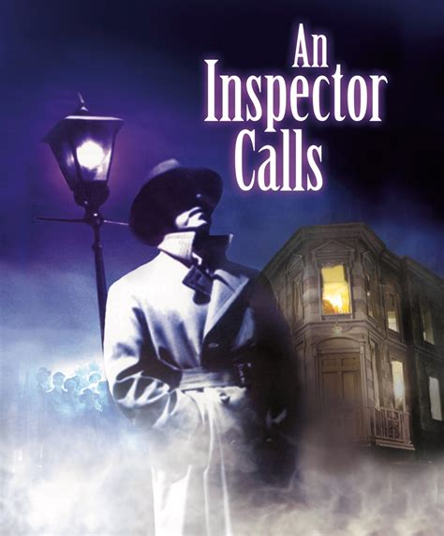
English Literature PLC
Autumn PPE

Slide 2
English Literature PLC Name: ____Target Grade: ____ Target Level:___
AIC Part A Mark ______ out of 20: Grade = _____
I can make Links | I can make a point | I can use evidence | I can use terminology | I can Analyse | I can apply Context | I know and can use some critical vocab
AIC Part B Mark ______ out of 20: Grade = _____
I know the Key Extracts and enough quotes | I can make a point | I can use evidence | I can use terminology | I can Analyse | I can Link back to the question | I know and can use some critical vocab
WotW Mark ______ out of 40: Grade = _____
I know the Key Extracts and enough quotes | I can make a point | I can use evidence | I can use terminology | I can Analyse | I can Link back to the question to develop an argument | I know and can use some critical vocab

Slide 3
Grades to Levels (roughly)
If your target is Grade 3, you need to have done everything in Level 2 (and a little bit of Level 3 to make sure).
If your target is Grade 4, you need to have done the main things in Level 3.
If your target is Grade 5, you need to have done everything in Level 3 (and a little bit of Level 4 to make sure).
If your target is Grade 6, you need to have done the main things in Level 4.
If your target is Grade 7, you need to have done the main things in Level 5.
If your target is Grade 8, you need to have done everything in Level 5.
To achieve Grade 9, you need to have done the main things in Level 6.

Slide 4
AIC part A The Mark Scheme
Level 6 (18–20marks)
Sustained critical style in an informed personal response to both text and task
• Coherent critical style sustained in an informed personal response to the text showing consistently perceptive understanding P
• Textual references and quotations are precise, pertinent and skilfully interwoven E
• Consistently effective use of relevant subject terminology T
• Detailed and well-developed analysis of writer’s use of language, form and structure to create meanings and effects A
• Perceptive and sensitive understanding of context and how it informs evaluation of the text C
• Achieves sustained interwoven comparison of texts LINK

Slide 5
AIC part A The Mark Scheme
Level 6 (18–20marks)
Sustained critical style in an informed personal response to both text and task
• Coherent critical style sustained; personal response; consistently perceptive understanding P
• Quotations precise, pertinent and skilfully interwoven E
• Consistently effective relevant subject terminology T
• Detailed and well-developed analysis of writer’s use of language, form and structure A
• Perceptive and sensitive understanding of context C
• Sustained interwoven comparison of texts LINK
Look at your teacher’s LinkPETALinkPETALink marking, what is there and what isn’t?
What is in brackets? (meaning you haven’t quite done it).
Now, look at the mark scheme you have been given – what elements have you hit your target Level in?
Which things are below your target level?
Go through the PLC putting the following symbols: ☺ = I am confident; 😐 = I am sometimes confident; ☹ = I am not confident
REMEMBERING THAT P and Link are the most important bits, decide what your biggest priorities are here and highlight these

Slide 6
AIC part B The Mark Scheme
Level 6 (18-20 marks)
Sustained critical style in an informed personal response to both text and task
• Coherent critical style sustained in an informed personal response to the text showing consistently perceptive understanding P and L
• Textual references and quotations are precise, pertinent and skilfully interwoven E
• Detailed and well-developed analysis of writer’s use of language, form and structure to create meanings and effects A
• Consistently effective use of relevant subject terminology T

Slide 7
AIC part B The Mark Scheme
Level 6 (18–20marks)
• Coherent critical style sustained in an informed personal response to the text showing consistently perceptive understanding P and L
• Textual references and quotations are precise, pertinent and skilfully interwoven E
• Detailed and well-developed analysis of writer’s use of language, form and structure to create meanings and effects A
• Consistently effective use of relevant subject terminology T
Look at your teacher’s PETAL marking, what is there and what isn’t?
What is in brackets? (meaning you haven’t quite done it).
Now, look at the mark scheme you have been given – what elements have you hit your target Level in?
Which things are below your target level?
Go through the PLC putting the following symbols: ☺ = I am confident; 😐 = I am sometimes confident; ☹ = I am not confident
REMEMBERING THAT P and A are the most important bits, decide what your biggest priorities are here and highlight these

Slide 8
WotW The Mark Scheme
Level 4 (19–24 marks) {<grades 4+to 7- are all in this level}
Credible critical style in a detailed personal response to both text and task
• Some critical style demonstrated in a detailed personal response to text, showing clear understanding P and L
• Relevant textual references and quotations are selected to support the response E
• Some analysis of writer’s use of language, form and structure to create meanings and effects A
• Competent use of relevant subject terminology T
• Clear understanding of context which informs the response to the text C

Slide 9
WotW The Mark Scheme
Level 4 (19–24 marks)
Credible critical style in a detailed personal response to both text and task
• Some critical style demonstrated in a detailed personal response to text, showing clear understanding P and L
• Relevant textual references and quotations are selected to support the response E
• Some analysis of writer’s use of language, form and structure to create meanings and effects A
• Competent use of relevant subject terminology T
• Clear understanding of context which informs the response to the text C
Look at your teacher’s PETALC marking, what is there and what isn’t?
What is in brackets? (meaning you haven’t quite done it).
Now, look at the mark scheme you have been given – what elements have you hit your target Level in?
Which things are below your target level?
Go through the PLC putting the following symbols: ☺ = I am confident; 😐 = I am sometimes confident; ☹ = I am not confident
REMEMBERING THAT P, A and L are the most important bits, decide what your biggest areas to work on are and highlight these

Slide 10
Where to look for help, once you’ve identified your weaker areas
Obviously, the BEST source of support is in your English Literature Lessons and Revision Sessions. Out of school, the following sites are useful:
An Inspector Calls | War of the Worlds | Romeo and Juliet
Key quotes, Extractsand Critical Vocab on SMHW GCSEpod – there are pods and questions on Plot, all characters and themes. BBC Bitesize GCSE English Literature OCR – includes learner guides, revision materials and ways to test yourself https://www.bbc.co.uk/bitesize/topics/z8mrqty Also some great short videos ar Clickrevision: http://www.clickrevision.com/beta/literature/an-inspector-calls/index.html | Key quotes, Extractsand Critical Vocab on SMHW Stream videos made by CDS staff are excellent revision resources: https://web.microsoftstream.com/video/b3c5b268-3e29-40df-b00e-ce4e8d612acb https://web.microsoftstream.com/video/2490edb9-f724-4c58-9125-26390a82c2da https://web.microsoftstream.com/video/a8ace990-cbe1-4e00-9093-775d85e388d7 https://web.microsoftstream.com/video/54bc26bc-2d66-4abd-b05b-83168cced7b5 https://web.microsoftstream.com/video/ec17d2ea-fc78-4141-a129-4f383854ce9f Shmoop is also useful here: https://www.shmoop.com/study-guides/literature/war-of-the-worlds-hg-wells | Key quotes, Extractsand Critical Vocab on SMHW GCSEpod – there are pods and questions on Plot, all characters and themes. BBC Bitesize GCSE English Literature OCR – includes learner guides, revision materials and ways to test yourself https://www.bbc.co.uk/bitesize/topics/zqhkxsg Shmoop is also useful here: https://www.shmoop.com/study-guides/literature/romeo-and-juliet

Slide 11
Grade Boundaries
Grade | Mark out of 20 | Mark out of 40 | Mark out of 80
9 | 17 | 34 | 68
8 | 15.5 | 31 | 61
7 | 13.5 | 27 | 53
6 | 11.5 | 23 | 45
5 | 9 | 18 | 36
4 | 7 | 14 | 28
3 | 5.5 | 11 | 21
NOTE:
These are the 2019 grade boundaries
Your work has been moderated in dept and against exam board material.
HOWEVER, the boundaries can shift.
What will your final mark in Eng Lit be out of?
Which mark scheme is going to be the most important for you?
So, which skills do you need to master the most?

