Slide 1
Year 11 Information Evening
Ms Kelly and Mrs Tsang
Thursday 19th September 2019

Slide 2
The Aims of the Evening
To provide parents and carers with the information they need to support their children in being successful in their exams, including:
Important dates, arrangements and administration
Guidance on homework and revision and how to help
Information about GCSE English and Maths
Managing anxiety and stress
Exam arrangements and progress tracking
Rewards

Slide 3
Important Dates
Year 11 Drama devised mock: Monday 4th November, after school
Year 11 Drama devised performance exam: Wednesday 20th November
6th Form Information Evening 21st November
Pre-Public Exams (PPEs) 25th November – 13th December
PARENTS EVENING 1 7th November
PPE RESULTS ASSEMBLY 15th January
PARENTS EVENING 2 23rd January
PPE – CORE SUBJECTS 2nd March
Information Evening 2 19th March?
Holiday Revision Classes Easter and May Half Term holiday
GCSE Dance exam 26th and 27th March
Art and Textiles GCSE Week of 27th April
START OF WRITTEN EXAMS 11th May
LEAVERS ASSEMBLY (AFTER PHYSICS GCSE) 12th June
PROM AND END OF YEAR 11 26th June
Sixth Form Taster Day 29th June
GCSE Results and 6th Form Enrolment 20th August from 10.30am

Slide 4
What Makes a Student Successful?
Excellent Attendance
Excellent Punctuality
Completing all homework
Using lessons wisely-listening, working hard, asking questions if needed
Good organisation
Enough revision
Effective revision
Exam practice questions
Maintaining motivation-having a post-16 goal
Support and encouragement at home

Slide 5
How Can You Help?
Check they are doing all homework (you can have parent login for SMH)
Ask them how you can help to support them with their revision
Help to make a revision timetable or tally chart.
Explore with your child different revision techniques
Encourage your child to attend after school revision classes
Help them to avoid distractions, e.g. agree where the mobile phone will go during revision time, set time limits for computer games
Offer to test them if they’ve been learning something
Praise/motivate/reward if needed

Slide 6
English
Two SEPARATELY GRADED Exams:
English Language – 2 exam papers
English Literature – 2 exam papers
BOTH are 100% exam

Slide 7
English
We use SHOW MY HOMEWORK
Quotation revision before tests
Exam questions to do at home

Slide 8
English
English Literature
Four ‘texts’:
An Inspector Calls
War of the Worlds
Romeo and Juliet
Love and Relationships Poetry Anthology (15 poems)
At least 120 quotes to learn

Slide 9
Maths-PRACTICE,PRACTICE,PRACTICE
Complete practice papers at home
MathsWatch online tool with help videos
Maths revision sessions after school on Mondays
Intervention – students will be selected to attend revision sessions in the morning during registration
Students should ask any Maths teacher for help if needed
Predicted papers in between each exam-students should collect them from Maths and complete them at home

Slide 10
Revision-what is appropriate?
2+ hours most nights either revising or completing homework (15 min slots)
Making notes, mindmaps, flashcards, memorising
Different strategies, e,g pacing, reciting notes to a rhythm or tune, reading notes out loud or in an accent
Completing exam papers and self-marking
Youtube videos-Science, Maths explanations
Use Personalised Learning Checklists or exam specifications to organise folders and tick off topics that have been completed
Use revision guides and workbooks
Useful Websites/ You tube channels
Mathswatch, Seneca Learning, BBC Bitesize
Youtube: Primrose Kitten – Science, Mr Bruff – English, FreeSciencelessons

Slide 11
Its Ok to not be OK
Signs of an Anxious Teen
Sleep issues
Difficulty concentrating (or revising)
Negative behaviour changes, e.g. increased anger
Increased irritability
Eating a lot more or a lot less
Some of you may be looking at this and thinking this is normal behaviour!

Slide 12
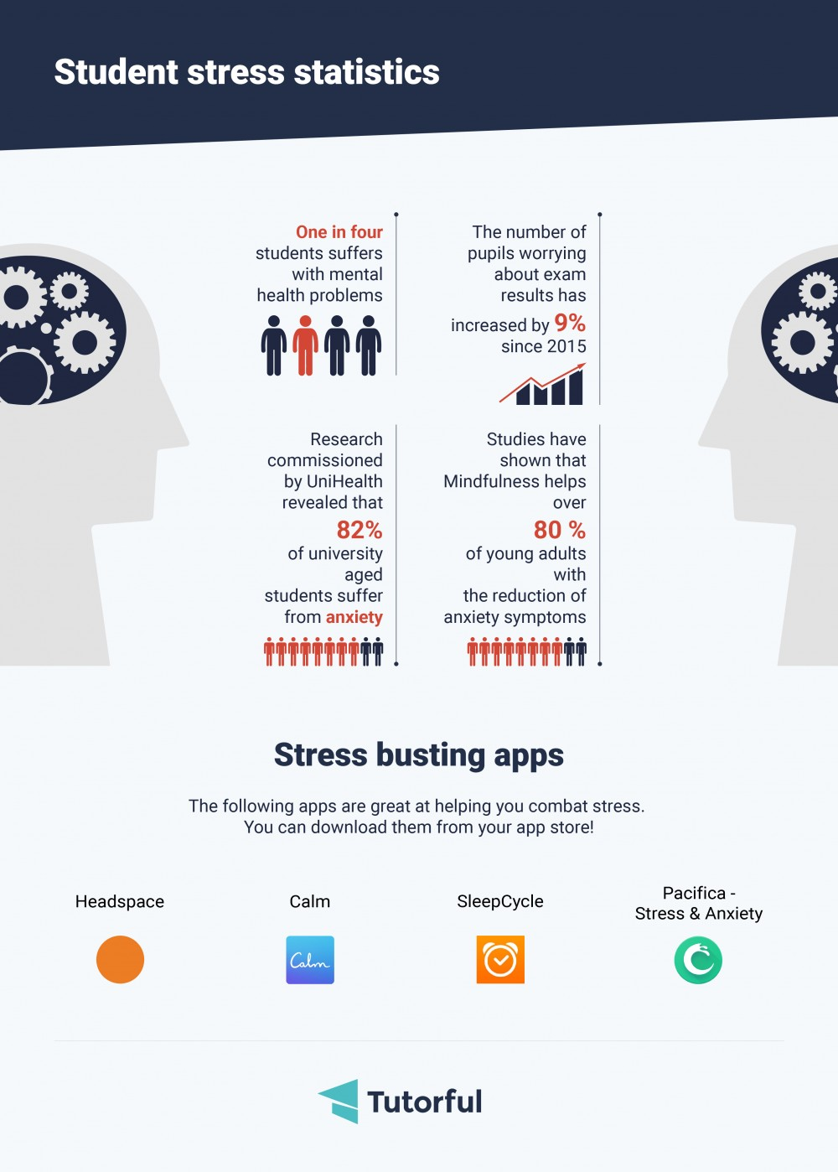

Slide 13
How Can You Help Them Cope?
Keep listening and helping them to find a solution
Calm environment and a space for study
Positive attention and time together on your own, e.g meal times
Discuss time management-hobbies, jobs, socialising-is the balance right?
Help with organisation and resources if needed, e.g. equipment ready the night before, check travel arrangements for exams to reduce stress
Healthy Lifestyles

Slide 14

Online counselling

Slide 15

Healthy Lifestyles
Eat breakfast and a drink
Drink water
Healthy snacks
Eat lunch
Plenty of fruit and vegetables
AVOID
fizzy drinks
Excessive sweets or chocolate
caffeine especially before bed

Slide 16
Healthy Living
8 hours sleep or more
Calm time before sleep
Exercise
Balance between revision and relaxation
Early night before exams
NOT computing before sleep
NOT texting in the night
NOT online computer games at night

Slide 17
Exam Advice
Know dates and times - students get an individual timetable with their final report and the whole school one is in the booklet
Text message reminders before all exams
Am or pm?
Morning exams: should be in the canteen at 8.30,
Afternoon exams: should be in the canteen by 1.10
Equipment
Black pens ( not erasable) you can write neatly with
Water bottle must not have labels on
Clear pencil case with a range of equipment
Must have their usual calculator for Maths and Science exams
Must hand in mobile phones or leave them at home
Don’t wear smart watches

Slide 18
Exam Expectations
Lateness
If running late, phone student services or reception or e-mail examsofficer@cdarwin.com
Students arriving late may not be admitted to the exam room
Illness Procedures
If very ill and so unable to attend the exam, need to get a doctor's note the same day and contact school (exams office by e-mail or students services by phone) that morning to tell us you aren't coming
We will send this to the exam board but they make very small/no consideration-they could end up with no score for that paper so should try to come in if at all possible
Students failing to attend their exam for no reason will be charged the cost of the entry for that exam, which will be from £35 to £48.50

Slide 20
Prom and rewards – Letter will be sent out this week
Reward Post cards – Given out approximately every 2 weeks for Aspire, Endeavour or Achieve
The aim is to get all 3. Students will bring these home on the day of assembly
Prom is a reward for those pupils who:
Have no exclusions during year 11
Are NOT in the red lowest band for effort or behaviour
Have 95% attendance or above
Are punctual to form and are not late more than 6 times in a half term
Are respectful and cooperative with staff in school
Behave appropriately in the wider community this includes travelling to and from school

Slide 21
And Finally…..
Please get in touch if you need to
Form Tutor
Class Teacher
Heads of Department
Mrs Gater
Mrs Tsang
Ms Kelly
Contact Details are in the booklet
Do you receive The Link every Friday? If not, we do not have your current e-mail address on the system

